Slide 1
Remote Control Emulator

Slide 2
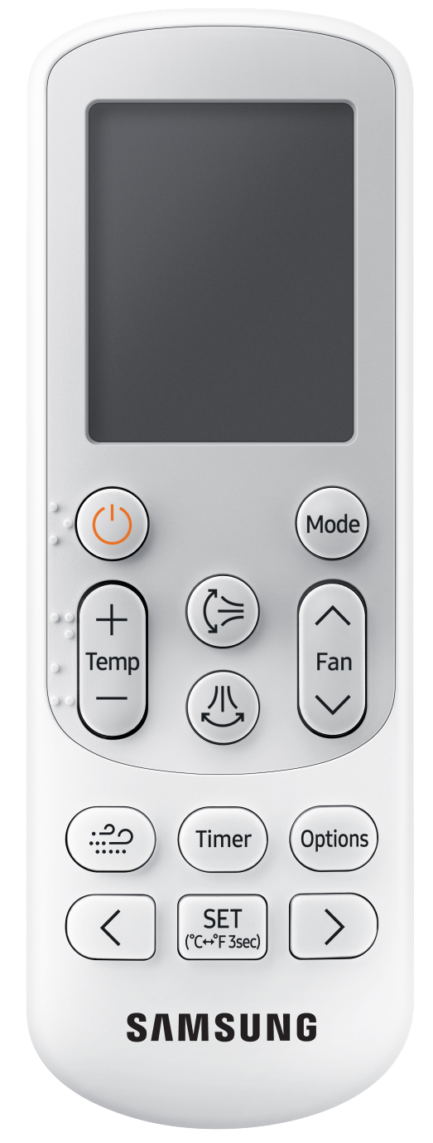


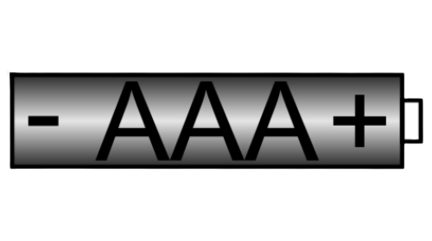
Entering the programming mode
Remove 1 battery from the controller.
Press the power button to drain power from the controller.
While holding the temp + & - buttons install the battery previously removed.
The display will show the mode in Auto, the operation status On and 00 will be displayed in the screen .
You are now ready to enter your option code.
The mode button changes the segment position.
The fan down button changes the 1st digit value.
The fan up button changes the 2nd digit value.
on
0
0
Auto

Slide 3
Segments 2 & 3
Segment 2
  Used to set option code function
Segment 3
  Not used Do Not Adjust
Seg 2 Seg 3
0
i
2
3
4
5
6
7
8
9
a
b
c
d
e
f
i
2
3
4
5
6
7
8
9
a
b
c
d
e
f
on
0
Auto
Segments
1 2 3 4 5 6 7 8 9 10 11 12 13 14 15 16 17 18 19 20 21 22 23 24
000000-100000-200000-300000

Slide 4
Segments 4 & 5
Segment 4
  Enable external temperature sensor
Segment 5
  Enables central control
Seg 4 Seg 5
0
i
2
3
4
5
6
7
8
9
a
b
c
d
e
f
i
2
3
4
5
6
7
8
9
a
b
c
d
e
f
on
0
Cool
0
i
2
3
4
5
6
7
8
9
a
b
c
d
e
f
i
2
3
4
5
6
7
8
9
a
b
c
d
e
f
0
Segments
1 2 3 4 5 6 7 8 9 10 11 12 13 14 15 16 17 18 19 20 21 22 23 24
000000-100000-200000-300000

Slide 5
Segments 6 & 8
Segment 6
  High Ceiling Mode
Segment 8
  Enables drain pump
Seg 6 Seg 8
0
i
2
3
4
5
6
7
8
9
a
b
c
d
e
f
i
2
3
4
5
6
7
8
9
a
b
c
d
e
f
on
0
dry
Segments
1 2 3 4 5 6 7 8 9 10 11 12 13 14 15 16 17 18 19 20 21 22 23 24
000000-100000-200000-300000

Slide 6
Segments 9 & 10
Segment 9
  Not used Do Not Adjust
Segment 10
  Not used Do Not Adjust
Seg 9 Seg 10
0
i
2
3
4
5
6
7
8
9
a
b
c
d
e
f
i
2
3
4
5
6
7
8
9
a
b
c
d
e
f
on
0
Fan
Segments
1 2 3 4 5 6 7 8 9 10 11 12 13 14 15 16 17 18 19 20 21 22 23 24
000000-100000-200000-300000

Slide 7
Segments 11 & 12
Segment 11
  Wind Free Speed
Segment 12
  Dew removal in wind free mode
Seg 11 Seg 12
0
i
2
3
4
5
6
7
8
9
a
b
c
d
e
f
i
2
3
4
5
6
7
8
9
a
b
c
d
e
f
on
0
Heat
Segments
1 2 3 4 5 6 7 8 9 10 11 12 13 14 15 16 17 18 19 20 21 22 23 24
000000-100000-200000-300000

Slide 8
Segments 14 & 15
Segment 14
  Use of external control
Segment 15
  Setting the output of external control
Seg 14 Seg 15
0
i
2
3
4
5
6
7
8
9
a
b
c
d
e
f
i
2
3
4
5
6
7
8
9
a
b
c
d
e
f
0
off
Auto
Segments
1 2 3 4 5 6 7 8 9 10 11 12 13 14 15 16 17 18 19 20 21 22 23 24
000000-100000-200000-300000

Slide 9
Segments 16 & 17
Segment 16
  Not used Do Not Adjust
Segment 17
  Buzzer Control
Seg 16 Seg 17
0
i
2
3
4
5
6
7
8
9
a
b
c
d
e
f
i
2
3
4
5
6
7
8
9
a
b
c
d
e
f
0
off
Cool
Segments
1 2 3 4 5 6 7 8 9 10 11 12 13 14 15 16 17 18 19 20 21 22 23 24
000000-100000-200000-300000

Slide 10
Segments 18 & 20
Segment 18
  Filter timer
Segment 20
  Individual control of the remote control
Seg 18 Seg 20
0
i
2
3
4
5
6
7
8
9
a
b
c
d
e
f
i
2
3
4
5
6
7
8
9
a
b
c
d
e
f
0
off
Dry
Segments
1 2 3 4 5 6 7 8 9 10 11 12 13 14 15 16 17 18 19 20 21 22 23 24
000000-100000-200000-300000

Slide 11
Segments 21 & 22
Segment 21
  Heating offset
Segment 22
  Not used Do Not Adjust
Seg 21 Seg 22
0
i
2
3
4
5
6
7
8
9
a
b
c
d
e
f
i
2
3
4
5
6
7
8
9
a
b
c
d
e
f
0
off
Fan
Segments
1 2 3 4 5 6 7 8 9 10 11 12 13 14 15 16 17 18 19 20 21 22 23 24
000000-100000-200000-300000

Slide 12
Segments 23 & 24
Segment 9
  MDS installation option setting
Segment 24
  Not used Do Not Adjust
Seg 23 Seg 24
0
i
2
3
4
5
6
7
8
9
a
b
c
d
e
f
i
2
3
4
5
6
7
8
9
a
b
c
d
e
f
0
off
heat
Segments
1 2 3 4 5 6 7 8 9 10 11 12 13 14 15 16 17 18 19 20 21 22 23 24
000000-100000-200000-300000

